Slide 1
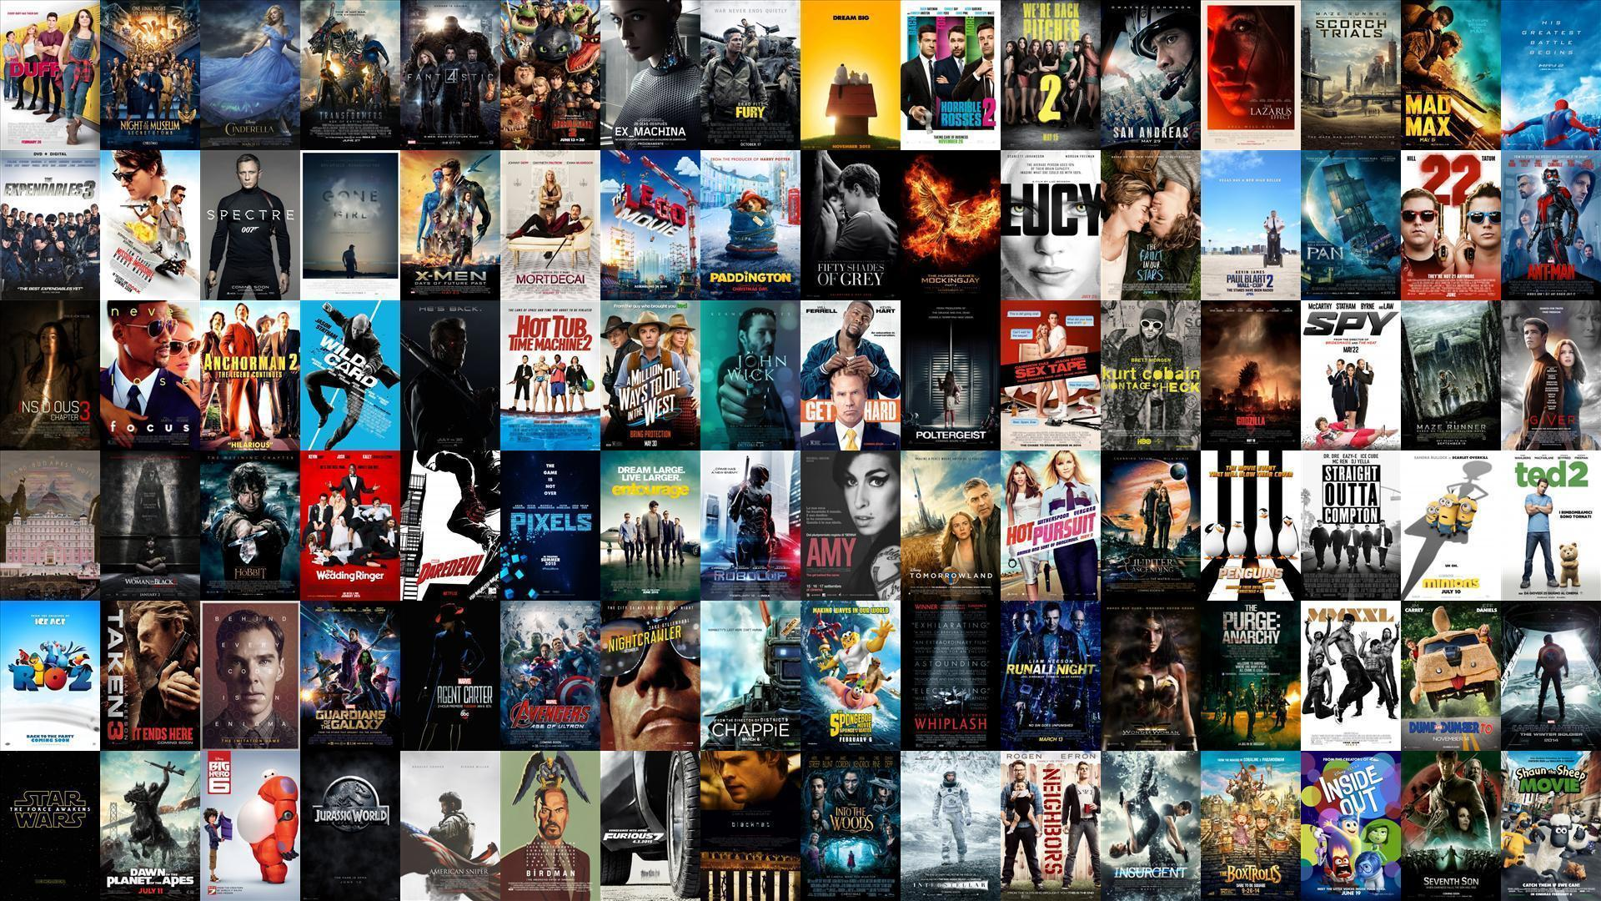
Sprint 3 - Moviender
Agile Methods for Data Science
Team: A3
12/12/2024

Slide 2
Summary
Sprint implementation days | 7 |  |  | Effort | Remaining on implementation day…
Trend calculated based on last | 7 | Days | Totals | 49 | 49 | 35 | 27 | 29 | 20 | 12 | 8
Task name | Story ID | Responsible | Status | Est. | 1 | 2 | 3 | 4 | 5 | 6 | 7
Readapt the model in order to take in consideration the selection of the movie's genre made by the user | 22 | Data science team | Done | 9 | 9 | 7 | 7 | 7 | 7 | 0 | 0
Add a filter button to the website to select the movie's genre | 22 | Tom | Done | 9 | 9 | 4 | 1 | 1 | 0 | 0 | 0
Log in in the website | 15 | Tom | Planned | 5 | 5 | 5 | 5 | 5 | 5 | 5 | 5
search functionalities | 21 | Tom | Done | 4 | 4 | 2 | 0 | 0 | 0 | 0 | 0
grid of movies that the user can rate from 1-5 | 21 | Tom | Done | 3 | 3 | 3 | 3 | 0 | 0 | 0 | 0
submission button | 21 | Tom | Done | 3 | 3 | 3 | 3 | 1 | 0 | 0 | 0
grid of reccomended movies | 21 | Tom | Done | 3 | 3 | 3 | 3 | 0 | 0 | 0 | 0
one end point for reccomendation | 21 | Martin | Done | 13 | 13 | 8 | 5 | 2 | 0 | 0 | 0
bug - frontend: the website is delayed | 21 | Tom | Done | 0 | 0 | 0 | 0 | 13 | 8 | 7 | 3
Notes:
Start the presentation recalling you our project and our final idea
Last time we started asking you a question: have you ever spent hours scrolling netflix looking for a movie to watch without finding anything?
But we also gave you THE solution: our movie reccomendation system Movinder: easy, interactive, perfect for each occasion and thought for YOU

Slide 3
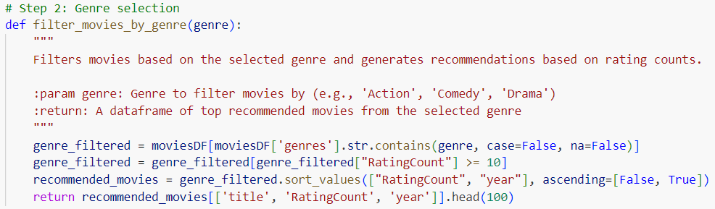
Final model
Filter by genre
KNN
Notes:
But I know that you are also interested in all the updates that we have developed in these two weeks
I’d like to start by presenting you the model that we have finally selected since performing the best model selection has been the most challenging part of this sprint
We started developing the idea of the like/dislike button as we described you two weeks ago
However, after a better understanding of the ds, we saw that the movies were rated into a scale from 1 to 5
So, our first idea has been to convert these rates into a binary value
Punti problematici: sebastian

Slide 4
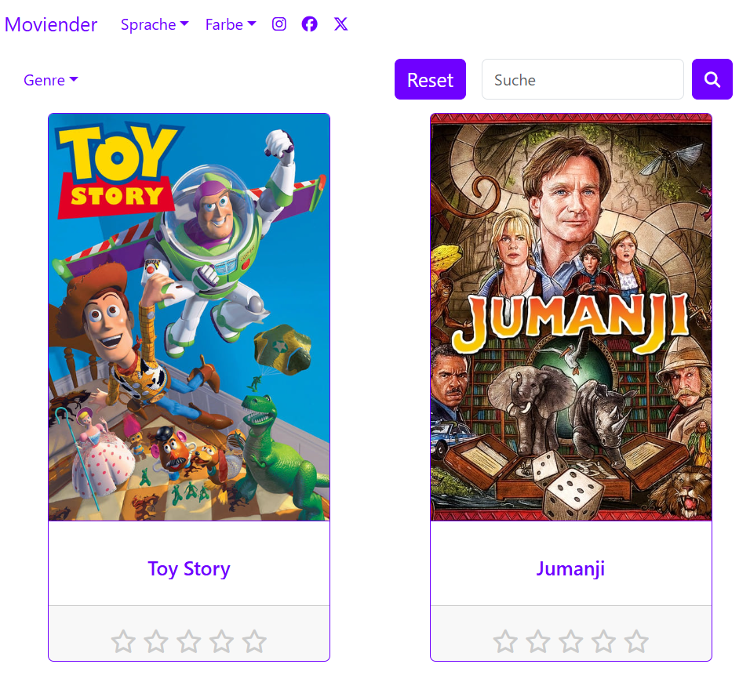
Final website
Frontend:
React
Search button
Submission button
Backend:
Flask

Slide 5
Final product - Moviender
Agile Methods for Data Science
Team: A3
12/19/2024

Slide 6

Product Vision
Have you ever been on a movie night but could not find the perfect movie?
Moviender is the solution for you! An easy-to-use and interactive website that always recommends you the perfect movie for your occasion.
Notes:
Start the presentation recalling you our project and our final idea
Last time we started asking you a question: have you ever spent hours scrolling netflix looking for a movie to watch without finding anything?
But we also gave you THE solution: our movie reccomendation system Movinder: easy, interactive, perfect for each occasion and thought for YOU

Slide 7
Product Backlog
Story ID | Story name | Status | Size | Sprint | Priority | Comments
1 | Understand the data | Done | 13 | 1 | 0 | We'd like to have a better comprehension of the data in order to define the best model
14 | Prototype of website | Done | 13 | 1 | 1 | First version of our final product that we'll show to our inverstors
15 | Define user profiles | Planned | 40 | 3 | 2 | Basic (free) and premium (subscription)
16 | Create an app | Removed | 13 | 3 | 2 | Adapt to website to a mobile device
17 | Update data | Removed | 8 | 3 | 1 | Post-evaluation of the movie done by the user to update the distance of the movie wrt the others
19 | Market research | Done | 13 | 2 | 1 | How much our users would like to pay for the subscription to the website?
18 | Add links to the website | Removed | 8 | 3 | 1 | Add the links to the biggest streaming website in which the user can find the suggested movie
20 | Build the model | Done | 30 | 2 | 0 | Output: list of the 5 most similar movies to the ones inputed by the user
21 | Build the website | Done | 26 | 3 | 2 | We need an architecture to store the input data from the user, per user
22 | Filter the movie by the genre | Done | 20 | 2 | 1 | We will suggest the movies to our users based on the genre that the'll select

Slide 8
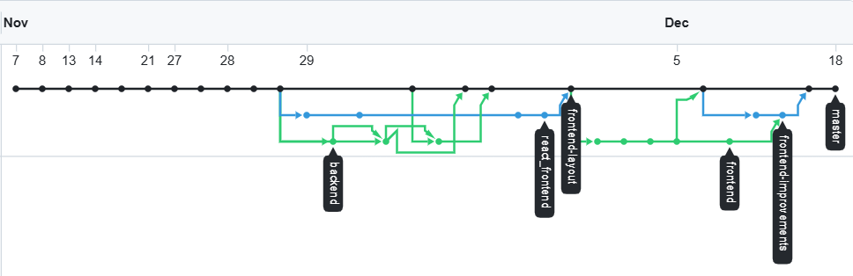
Methodology
Github:
Excel sheet
Notes:
Github but problems with the permits so excel file still comunication pbs

Slide 9
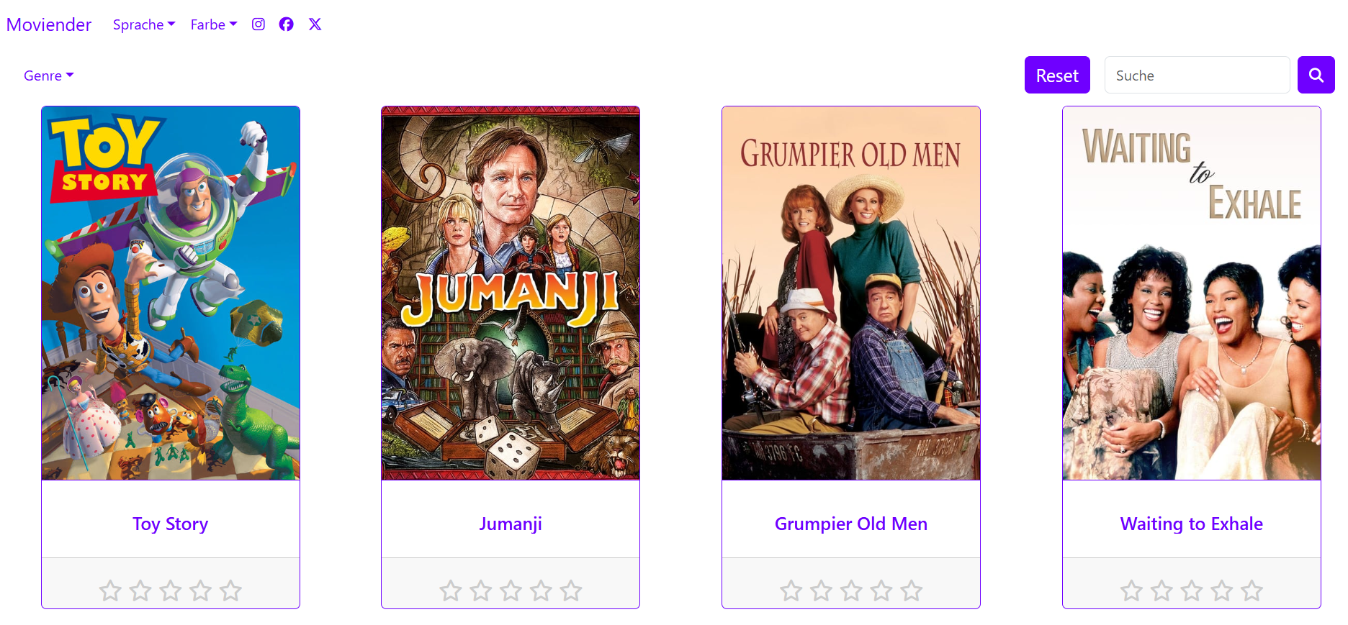
Final product

Slide 10
Let‘s revolutionise movie nights together! Moviender

